Slide 1
6+++++
School Health Program
Marjorie Cole, MSN, RN, FASHA
Missouri State School Nurse Consultant

Slide 2
Bureau of Community Health and Wellness
Adolescent Health Program
Sexual Risk Avoidance
Personal Responsibility Education
Program
Missouri Tobacco Prevention and Control Program
Community
Health
&
Building Communities for Better Health
Physical Activity and Nutrition Program
School Health Program
Injury / Violence Prevention
Safe Kids Coalition
Notes:
The School Health Program is under the Bureau of Community Health and Wellness, with other programs that promote health, nutrition and activity. Some of these programs in our unit include the Tobacco Prevention and Control Program, the Adolescent Health Program, obesity initiatives like the Healthy Communities and Team Nutrition, and the Injury and Violence Prevention program.

Slide 3
Public, Charter, Private and Parochial schools
School Health Services
in Missouri
Health Room services by RNs, LPNs and Health Aides
Promote best-practices in school health services:
Vision and hearing screening
Chronic conditions in the school setting (i.e., asthma, life-threatening allergies, diabetes, seizures)
Communicable and infectious disease control
Medication administration
Training and Professional Development:
Health Office Orientation
Nurse Education Webinar Series (N.E.W.S.)
Show-Me ECHOs
Lead School Nurse Collaborative
Notes:
The School Health Program serves the school districts and health services staff, which is RNs, LPNs and Health Aids, in
558 Public School Districts, as well as the Charter, private and parochial schools in Missouri.
Promote Best Practice in School Health Services:
• Vision and Hearing screening practice recommendations
• Current resources for managing chronic conditions in school settings—Asthma, Diabetes, Life-Threatening Allergies,
Infectious and Communicable Disease control
• Tools for safe practices in Medication Administration
Facilitates Training and Professional Development:
• Annual Health Office Orientation workshop
• Nurse Education Webinar Series (NEWS) and the Show-Me ECHOs specific to student health and chronic conditions
• Annual Lead School Nurse Collaborative

Slide 4
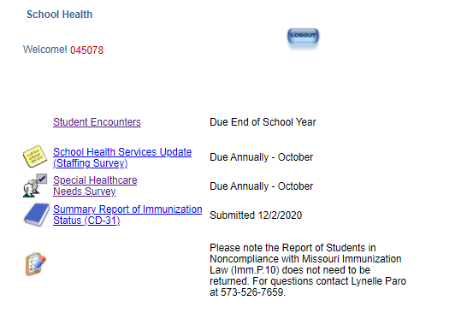
Data
School Health maintains a database for annual reporting, which is open to all schools in Missouri.
Notes:
Another thing that school health services programs do is data reporting. The SHP maintains a database for annual reporting, which is open to all schools in Missouri. Because schools, and particularly school nurses, have so much information about children in Missouri, this system allows us to collect real-time, state-level data we can share with our state and local leaders.
The Bureau of Immunizations partners on this for the school nurses to submit their annual Immunizations Compliance reports through this system each October. Back to school is always a busy time for LPHAs and school nurses to get students in for the immunizations they need to get caught up to enroll in school.
School Nurses also collect a lot of really good information with student enrollment.

Slide 5
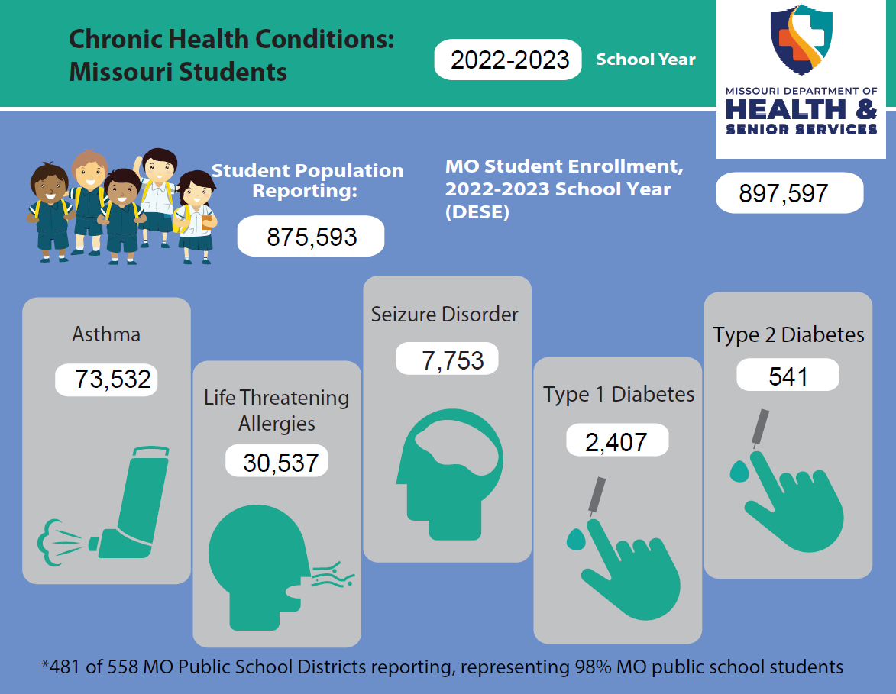
Special Health Care Needs and Chronic Conditions
Notes:
The Online Reporting System provides a platform for school nurses to share information about the chronic health conditions and healthcare needs of their district’s student population. These aggregate reports can then be compiled from the database to report on healthcare needs of students at the county and state-levels. This report includes things like number of students with Asthma, Diabetes, Seizures, and Life threatening Allergies that can be compared with national data. The broad listing of conditions including cancer, hearing impairment, genetic and autoimmune disorders, and mental health diagnoses helps provide a picture of the health and care needs of the population, and more broadly, the community. The annual state-level report is posted on the School Health web page in both report and with infographics.

Slide 6
Student Health Data
 | Missouri Schools | Nationwide
Life-threatening Food Allergies | 2.5% | 4%
Asthma | 8.4% | 7-10%
Seizure Disorders | 0.9% | 0.7%
Diabetes | 0.3% | 0.3%
Notes:
The SHP uses the annual Special Health Care Needs and Chronic Conditions reports to compare how Missouri is trending, compared with the national student population. Resources from the CDC provide the national rates for a few key health indicators—
Life Threatening Allergies, where MO shows slightly below the 4% national rate
Asthma where MO trends on the higher end with just over 9% compared to the national numbers
Diabetes in MO students is about even with the nation, and for
Seizure disorders, MO continues to trend higher than rates across the country.

Slide 8
Professional Staff
in the Health Office
Students are safer because we have nurses and trained staff in the health room.
Notes:
Also included in the School Health Online Reporting System (SHORS)is the Staffing Survey. This annual report provides us at the SHP with the contact information for the lead nurses and school health room staff. We use this for communicating updates and just-in-time information to school nurses through our ‘News You Can Use’ emails. This allows us to connect with schools and health office staff directly. We can target information by region, by county, or any project specific needs based on student enrollment or otherwise.
We also complete an annual report from this staffing survey. This includes the nurse to student ratio, the number of professional and unlicensed staff in health rooms, as well as the training and educational preparation of the health office personnel. We find from this report that in many of our smaller rural schools, professional staff is not always an option, and in the case of LPNs and Health Aides, it is often difficult to find the necessary RN/MD supervision for the practice. Many LPHAs in Missouri have been great to step up and support their school health services, providing staff to cover the health office, signing on to provide the RN/MD supervision required for LPN practice, and supporting health education in the districts. We are always available to, with LPHAs to help you all connect with your schools.

Slide 9
Current Services and Projects
Collaborative Infection Prevention and Control Training
Whole Student
Wellness Workshops
Show Me
School Health
Show Me Strong Kids ECHO
Show Me
School Health

Slide 10
Current Services and Projects
Missouri TEAMS
Health services Assessment Tool for Schools (HATS)
Poverty Simulation Training for Missouri Schools
N.E.W.S.
Nurse Education Webinar Series

Slide 11
Current Services and Projects
SN CHAT
School Nurse Chronic Health Assessment Tool
Health Office Orientation
National School Nurse Certification

Slide 12
